Slide 1
Investigating Commercial Pay-Per-Install and the Distribution of Unwanted Software
Kurt Thomas, Juan A. Elices Crespo, Ryan Rasti, Jean-Michel Picod, Cait Phillips, Marc-André Decoste, Chris Sharp, Fabio Tirelo, Ali Tofigh, Marc-Antoine Courteau, Lucas Ballard, Robert Shield, Nav Jagpal, Moheeb Abu Rajab, Panayiotis Mavrommatis, Niels Provos, and Elie Bursztein, Google; Damon McCoy, New York University and International Computer Science Institute
25th USENIX Security Symposium
August, 2016

Slide 2
Outline
Introduction
Illustrate PPI Affiliate Structure
Monitoring the PPI Ecosystem
Exploring Commercial PPI Offers
Measuring User Impact
Distribution Techniques
Conclusion

Slide 3
Outline
Introduction
Illustrate PPI Affiliate Structure
Monitoring the PPI Ecosystem
Exploring Commercial PPI Offers
Measuring User Impact
Distribution Techniques
Conclusion
Notes:
首先先做一個概略的介紹

Slide 4
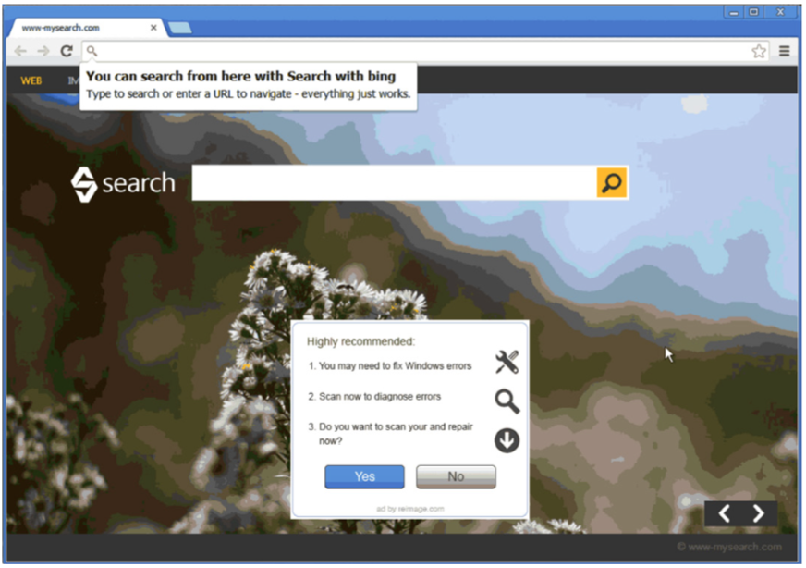
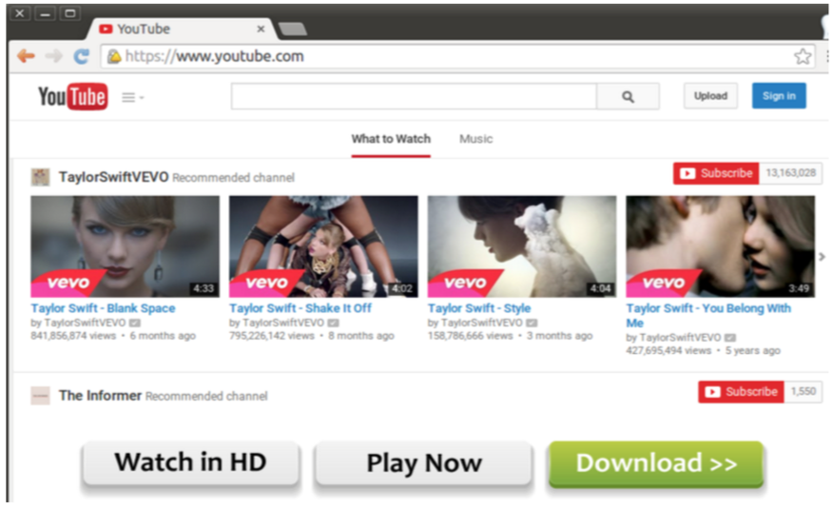
Unwanted Software has risen up
In recent years, unwanted software has risen to the forefront of threats facing users.
Notes:
作者提到近年來unwanted software出現的越來越頻繁
所謂的unwanted software有點像malware, 但有的其實沒有惡意, 只是是很惱人的軟體或是不需要的軟體
例如Browser setting hijacker會改搜尋引擎內容或是改首頁 (hao123)
ad injector會裝一堆廣告在瀏覽器上

Slide 5
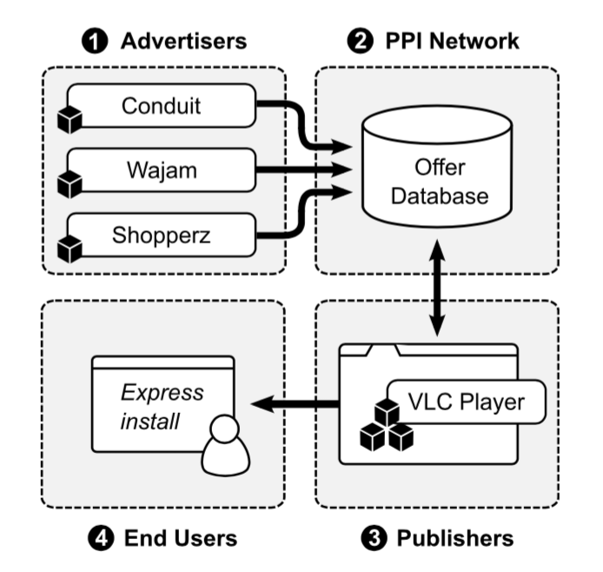
What is “Commercial Pay-Per-Install” ?
Notes:
這篇文章主要是在介紹Commercial PPI
是一種用金錢來換取散布軟體的機制
會有軟體開發者(Publisher)去申請，願意把他們的應用程式和其他第三方的應用程式包在一起,
當有使用者安裝Publisher的東西時,有可能會順便把其他的第三方應用程式也一起安裝下去，
如果安裝成功，這個publisher就會收到其他第三方應用程式付的錢

Slide 6
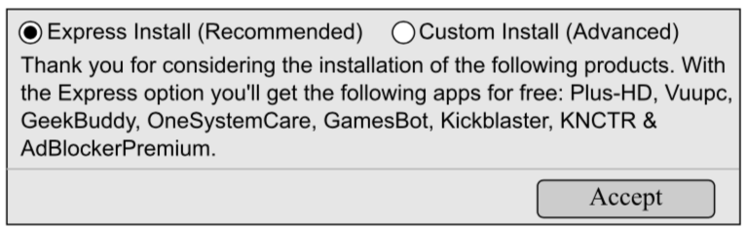
Commercial Pay-Per-Install
Sample prompt bundling eight commercial pay-per-install offers. Each offer is downloaded and automatically installed upon a user accepting the “Express Install” option.
Notes:
舉個例子, 當安裝了某軟體後, 會問你要不要順便安裝一些搭配的東西
這邊有8個offers
Offer的原意是提供在這篇文章的意義是指由第三方提供的unwanted software binaries
那這些搭配的軟體有一些在VirusTotal中被至少一個Anti-virus引擎標為unwanted software.

Slide 7
Safe Browsing telemetry
Authors measure the impact of commercial PPI on end users across the global via Safe Browsing telemetry.
On an average week, Safe Browsing generates over 60 million warnings related to unwanted software delivered via PPI – three times of malware.
However, there are still tens of millions of installs on user systems.
Safe Browsing
Security team in Google built Safe Browsing to identify unsafe websites and notify users and webmasters so they can protect themselves from harm.
Google’s Safe Browsing technology examines billions of URLs per day looking for unsafe websites.
Notes:
這篇文章在很多需要統計commercial PPI所照成的影響時, 都是使用SafeBrowsing工具
這個工具是當使用者如果去瀏覽被判斷為惡意的網站時，google的安全瀏覽會跳出警告, 同時在google公司會做一些log
統計發現: 平均每週都會產生6000萬的unwanted software警告
但還是有數以千萬計的這種軟體被安裝在user system上

Slide 8
Outline
Introduction
Illustrate PPI Affiliate Structure
Monitoring the PPI Ecosystem
Exploring Commercial PPI Offers
Measuring User Impact
Distribution Techniques
Conclusion
Notes:
接下來會介紹PPI聯盟網路的架構, 同時也會提到作者他們拿到的樣本

Slide 9
PPI Affiliate Structure
To simplify the process of buying and selling installs, commercial PPI operates an affiliate network.
The pay-per-install affiliate structure consists of advertisers, publishers, and PPI affiliate networks.
Notes:
前面有提到CommercialPPI是一種第三方付錢給某軟體商,某軟體商只要讓他的產品被安裝之後就會獲得額外的金錢收入
在這個affiliate network中有四個角色 上面三個和end user

Slide 10
PPI Affiliate Structure
Advertiser – advertisers are software owners that pay third-parties to distribute their binaries or extensions.
What software advertisers can distribute falls entirely to the discretion of PPI affiliate network operators.
Advertisers recuperate PPI installation fees by monetizing end users via ad injection, browser setting hijacking, or user tracking.
Irrespective of the application’s behavior, PPI networks set a minimum bid price per install that advertisers only pay out upon a successful install.
Notes:
Advertiser 就是那些花錢要別人幫忙散播軟體的開發者
他們只負責提交軟體, 至於哪些會被選到要看經營PPI的人
回收這些投資的錢是從end user那邊收取
3. 不管application是做什麼用的，PPI網路都不管, PPI會設一個最低價錢，當安裝成功後advertiser就會付款。

Slide 11
PPI Affiliate Structure
Publisher – publishers (e.g., affiliates) are are the creators or distributors of popular software applications.
PPI networks re-wrap a publisher’s application in a downloader that installs the original binary in addition to multiple advertiser binaries.
Upon a successful install, the publisher receives a fraction of the advertiser’s bid.
Notes:
Publisher是那些創造或發佈有名軟體的人,
PPI網路會把這些有名的軟體重新包裝, 塞入一些advertiser的binaries, 做成一個downloader來讓user下載（就像前面那個範例）
如此一來，publishers只要專注在吸引用戶安裝，advertiser也不需要知道怎麼欺騙用戶來下載，更不用怕被單獨下載安裝

Slide 12
PPI Affiliate Structure
PPI Affiliate Network – PPI affiliates networks serve as a bridge between the specialized roles of advertisers and publishers.
The PPI networks manages all business relationships with advertisers, provides publishers with custom downloaders, and handles all payments to publishers for successful installs.
When a publisher gains access to an end user’s system, the PPI network fingerprints a victim’s machine for detecting hostile anti-virus or virtualized environments and determines which offers to install.
Notes:
PPI Affiliate network是一個作為advertiser和publisher中間橋樑的角色
負責管理金流, 也負責提供downloader
同時會負責檢查user環境 去偵測是不是有AV 或虛擬化環境 最後再決定要提供什麼offer

Slide 13
PPI Affiliate Structure
Reselling – With multiple PPI affiliate networks in operation, smaller PPI operators will aggregate their publishers’ install traffic and resell it to larger one.
These smaller PPI operators create value for their affiliates by providing promotional tools in the form of landing pages, banner ads, butter bars, and generic installers for media players and games.
These resellers rely on sub-affiliate tracking provided by larger PPI networks rather than operate their own downloader.
Notes:
Reselling是一個特別的狀況, 是一些比較小的PPI經營者會去整合他們所擁有的publisher資源, 然後賣給大公司,
可以把reseller當成是一個PPI的sub-affiliate network
這些reseller也會提供一些促銷的工具來創造他們的價值

Slide 14
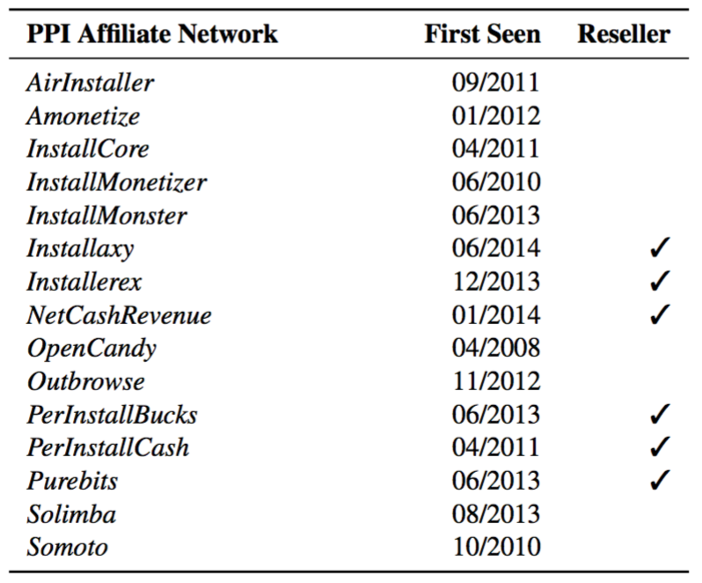
Acquiring PPI Downloader Samples
Authors acquired downloaders for 15 distinct PPI networks which have been in operation for 2-3 years.
Based on blackbox test of each downloader, they found 6 of the 15 PPI downloaders are resellers.
They elected four of the largest downloaders as the basis of their investigation.
Notes:
作者他們獲得了15個不同的PPI網路下載器
獲取PPI affiliate程式的資訊是經由查詢一些地下的論壇討論所發現的
經過了一些黑箱測試之後發現有6個是reseller，剩下的選了4個來做調查
四個最大的downloader的選法是根據Safe Browsing的統計報告來選的

Slide 15
Outline
Introduction
Illustrate PPI Affiliate Structure
Monitoring the PPI Ecosystem
Exploring Commercial PPI Offers
Measuring User Impact
Distribution Techniques
Conclusion
Notes:
這章節講作者他們去監控PPI網路的生態
並開發了一個pipeline去模仿downloader的protocol並下載那些PPI提供的binaries

Slide 16
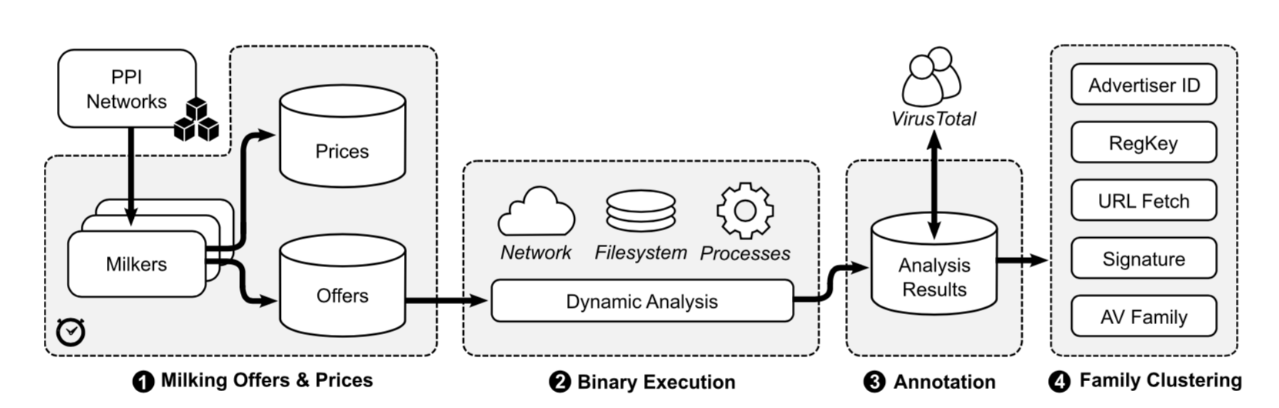
Analysis Pipeline
1
2
3
4
Notes:
首先會有個Milker 來模仿PPI的protocol做網路傳輸的動作, 獲取downloader給的那些offer binaries
接著把這些binaries在sandbox中作動態分析
再來做一些命名和標記
最後依照一些特定標準做一些分群的動作
後面會細講

Slide 17
PPI Downloader Protocol
All four PPI downloaders that authors study rely on a three-stage protocol for dynamically fetching advertiser binaries.
To start, a downloader fingerprints a client’s device to determine the operating system and default browser. The downloader reports these parameters to the PPI server as part of a request for all available offers.
Notes:
PPI downloader要下載那些附加的offer之前會先經過一個三段的protocol
首先會先偵測user的環境, 把這些環境塞到request之中給PPI server

Slide 18
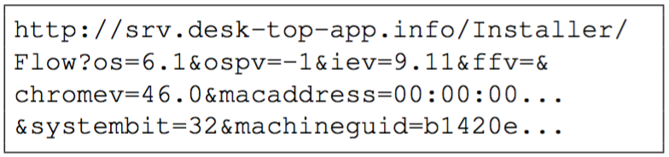
PPI Downloader Protocol
PPI network request Example
Version of OS and service pack
Present browser version
System is 32-bit or 64-bit
Potentially unique ID including a MAC address and a machine ID such as HKEY_LOCAL_MACHINE\ SOFTWARE\Microsoft\Cryptography
Notes:
這是一個request example 會把經過掃描的資訊塞進去request中

Slide 19
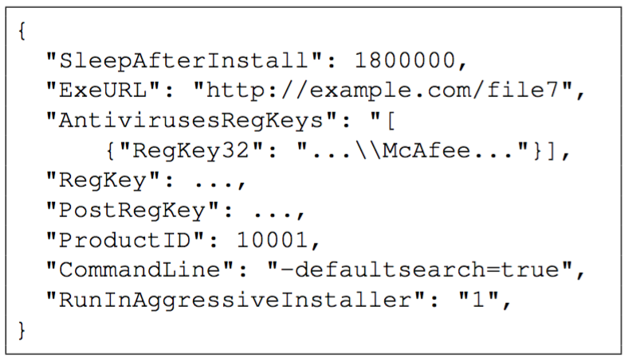
PPI Downloader Protocol
PPI network response Example
Unique product ID
Download URL
Additional metadata that dictates how the install process unfolds
Notes:
PPI server回的東西
包含product ID
下載的URL路徑
在安裝的時候要附加的設定 例如設成預設瀏覽器等

Slide 20
PPI Downloader Protocol
In the second stage, the downloader verifies that none of the RegKey or AntivirusesRegKeys are present in the device’s registry. This approach serves to prevent multiple installations of the same advertiser’s binary as well as to avoid anti-virus disrupting the installation of an offer.
If a client’s machine satisfies the offer criteria, the downloader will display the offer and execute the binary with the command line options specified by the PPI server if accepted.
If a client’s system does not satisfy the criteria, the downloader simply tests another potential offer until all options are exhausted.
Notes:
第二部分會檢查RegKey或AntiVirusRegKey，去看看有沒有重複的安裝或是避免被防毒軟體抓
如果client的機器符合條件的話，會提供binary，並且執行時會帶有一些command line options
作者提到這些commandline option有時會揭露一些advertiser的意圖，例如替換預設搜尋引擎等

Slide 21
PPI Downloader Protocol
In the final stage, the downloader reports all successfully installed offers along with the publisher’s affiliate id for compensation.
Notes:
會紀錄成功的安裝和publisher的ID用於付錢用

Slide 22
Developing Longitudinal Milkers
In order to track bundled offers, authors develop milkers that replay the first stage of each PPI network’s offer protocol and decode the response.
Notes:
作者他們開發了一個Milker來重複剛剛的第一步驟
第一步包含偵測環境和送出request
發出request裡面的環境資訊 包含Win7 OS, 裝了Chrome和IE, 並隨機生成MAC address和MachineID

Slide 23
Developing Longitudinal Milkers
Upon receiving a response, authors decode the list of offers and extract the associated URL of the offer binary.
They reiterate that the PPI programs they monitor provide anywhere from 5–50 potential offers along with their installation requirements.
For each offer, authors detect whether they previously observed the URL of the associated binary.
URL is fresh -> download the URL’s content
URL is redundant -> rely on a cached copy in order to reduce network load on the PPI servers
Notes:
如果Milker收到response，作者他們會去decode並取得URL
每個PPI下載器會提供5~50個offers
會檢查這些URL，如果是新的就下載內容 如果是重複的就用之前的內容

Slide 24
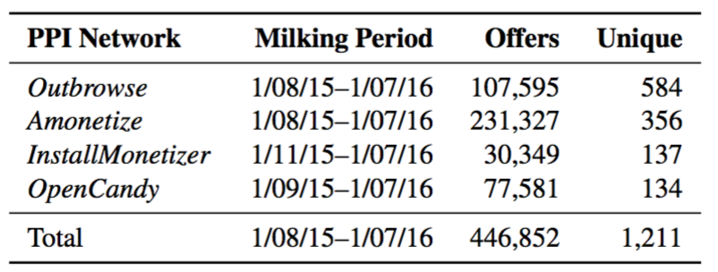
Developing Longitudinal Milkers
Authors finally store each binary, the offer metadata (e.g., registry requirements, advertiser ids), and the timestamp of execution.
They ran milkers every hour from a collection of cloud instances hosted in the United States over a year long period from January 8, 2015–January 7, 2016.
In total, authors collected 446,852 offers. These offers contained 2,841 unique URLs, 1,809 unique digests, and 1,211 unique product ID.
Notes:
作者他們執行milker執行了一年
獲取了446,852個offers

Slide 25
Tracking Regional Pricing of Commercial PPI
Because of the exact daily prices that advertisers pay per install are available only to publishers delivering successful installs, authors track the average price per install across the PPI ecosystem as publicly advertised by PPI networks and resellers to attract affiliates.
In total, they identify five PPI-related websites that provide a breakdown of the current price per install paid across 219 regions, with rates varying between $0.01–$2.09.
These sites include cinstaller.com, installmania. com, cashmylinks.com, perinstallbucks.com, and truemediaparnter.com.
Notes:
關於計價方面, 作者他們並沒去註冊成為一個publisher，所以沒辦法獲得真的定價
他們是用一些公開的資訊來做平均估計
每個下載的價碼約在0.01~2.09美金之間，依照地區有所不同

Slide 26
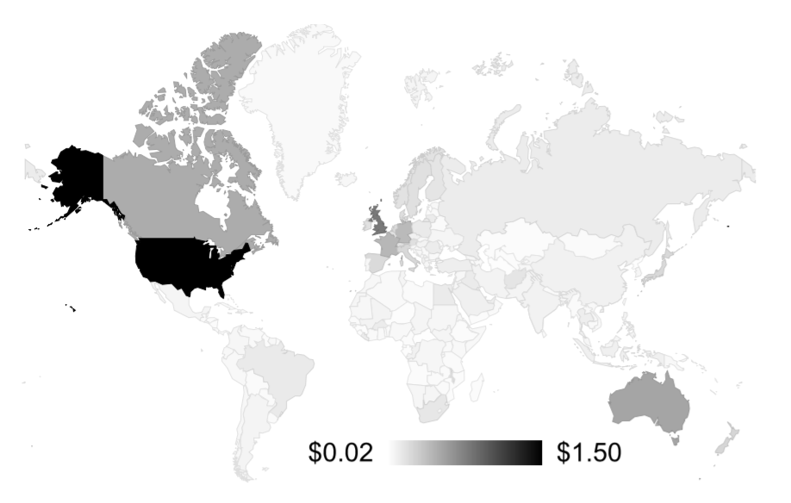
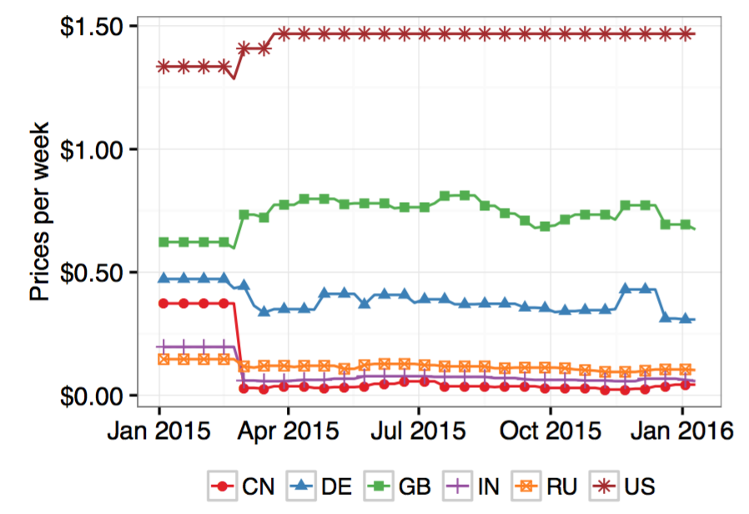
Regional Pricing Per Install
Notes:
advertiser每次成功安裝所付出的錢
美國大約1.5美金, 英國0.8, 日本排第三 其他的就落在0.02-0.1之間
右邊的圖是價錢變動的幅度 發現變動通常不大

Slide 27
Executing and Annotating Offers
Authors execute all downloaded binaries in a sandboxed environment similar in flavor to Anubis, CWSandbox, and GQ.
log all network requests and responses , file system changes, modified registry keys, and spawned processes.
monitor whether the executable changes any preferences related to Chrome or Internet Explorer.
They annotate each binary with third-party intelligence gathered through VirusTotal at the end of our collection period.
Also collecting any labels that 61 anti-virus engines labelled the binary.
Notes:
作者他們執行所有的binaries在sandbox中 類似…
記錄所有的網路傳輸, 檔案系統變動, Registry key修改和衍生出來的processes等資訊
也紀錄瀏覽器偏好設定的更改，像是改預設browser, 安裝extension, 修該首頁等
這些註釋都會送去VT來做labelling，並搜集這些標籤

Slide 28
Clustering and Classifying Offers
Authors classified all of the advertiser binaries in our dataset into distinct families.
to de-duplicate instances where the same advertiser works with multiple PPI networks or where advertisers introduce polymorphism due to software updates, sub-affiliate programs, or to evade detection by anti-virus engines.
Through all clustering techniques, authors generate 873 non- overlapping clusters
Notes:
到第四部，作者他們去對所有的binaries做分群，來區分家族，最後分出了873個不重複的家族
分群是為了上面兩個紅色的目標

Slide 29
Classification Process
Authors classified all binaries based on
overlapping registry key modifications
domains contacted during execution
process names
digital certificates used to sign the advertiser’s software (only 58% of offers were signed)
Notes:
分群的標準是基於…

Slide 30
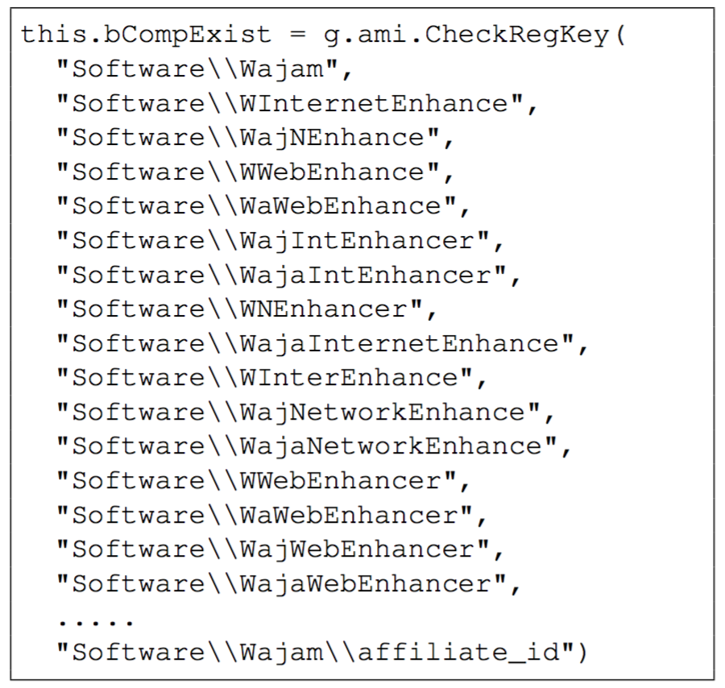
Classification Process
Authors also cluster offers based on the registry keys present in the installation pre-conditions provided by PPI networks during offer selection.
These pre-conditions unambiguously reveal all of the registry paths controlled by a single family, such as Wajam which installs under 418 unique registry keys.
Authors cluster offers that contain the same registry checks.
Notes:
另外分群也有基於在安裝前由PPI網路提供的資訊
前面在response的時候有為了不重複安裝所以提供一些register key，作者利用這一點來做分群

Slide 31
Naming Clusters
Authors manually review all clusters active for more than 150 days totaling 58 distinct clusters.
Authors derive family labels based on the most common naming convention found in VirusTotal for a cluster.
If no public name exists, authors fall back to the advertiser name listed in the offer metadata provided by PPI networks.
For all clusters lasting less than 150 days, authors rely exclusively on the advertiser name.
Notes:
對於cluster活動超過150天的58個群，是以VT上最常用的命名來當作family name
如果沒有常用的命名，就用在metadata中advertiser的名稱來代替
如果少於150天的就直接用advertiser的名稱當作群名稱
但計算活動時間這件事情怎麼做的作者沒有細講

Slide 32
Limatations - 1
Authors’ pipeline runs exclusively from United States IP addresses.
This potentially biases the perspective of PPI offers in the event advertisers distribute exclusively to non-US territories.
But the US is the highest paid region for installs, which makes it one of the most interesting to analyze.
Notes:
作者他們只有搜集美國IP的相關資料跟offers，所以他們認為有可能造成偏誤

Slide 33
Limatations - 2
Lacking exact pricing details per install.
Because authors do not participate directly in the PPI ecosystem, they lack exact pricing details per install.
Authors attempt to extrapolate these values based on public pricing used to attract affiliates, but they cannot verify the accuracy of this data other than to corroborate similar rates cited within the underground.
Notes:
他們的價碼是用估計的，所以可能無法正確對應到真正的價碼

Slide 34
Limatations - 3
Family classification challenging where there is frequent disagreement between anti-virus naming conventions.
Authors reconcile these discrepancies for the longest running PPI campaigns at the expense of overlooking the long tail of brief campaigns.
Notes:
分群的時候做的命名可能會命錯，因為VT上的命名很常不一致
所以都用活動最久的offer來做命名

Slide 35
Limatations - 4
Perspective of PPI ecosystem is restricted.
perspective of the PPI ecosystem is restricted to four PPI networks due to the time-intensive process of building milkers.
While there is a risk our findings are not representative of the entire ecosystem, there is substantial overlap between the advertisers of each PPI network.
Notes:
由於時間的關係，研究範圍被局限在他們挑的4個PPI網路
從後面可以看到雖然這篇研究只挑了四個，但在後面可以看到這些PPI網路在advertiser做的事情這一塊有重複

Slide 36
Outline
Introduction
Illustrate PPI Affiliate Structure
Monitoring the PPI Ecosystem
Exploring Commercial PPI Offers
Measuring User Impact
Distribution Techniques
Conclusion
Notes:
這一章講一些作者他們對PPI network裡的Offer的一些發現，比較多是一些統計的量的描述，會快速帶過

Slide 37
High-Level Metrics
Using the 1,211 product identifiers embedded by PPI networks in each offer for accounting purposes, we calculate the total distinct simultaneous offers per PPI network and the duration that advertisers run each offer.
Notes:
首先先看一些統計的東西
作者他們利用Milking response裡帶的不同的productID，
去計算每個PPI網路每週會放出多少個不同的unwanted softwares，
還有各個advertiser更新software的時間週期

Slide 38
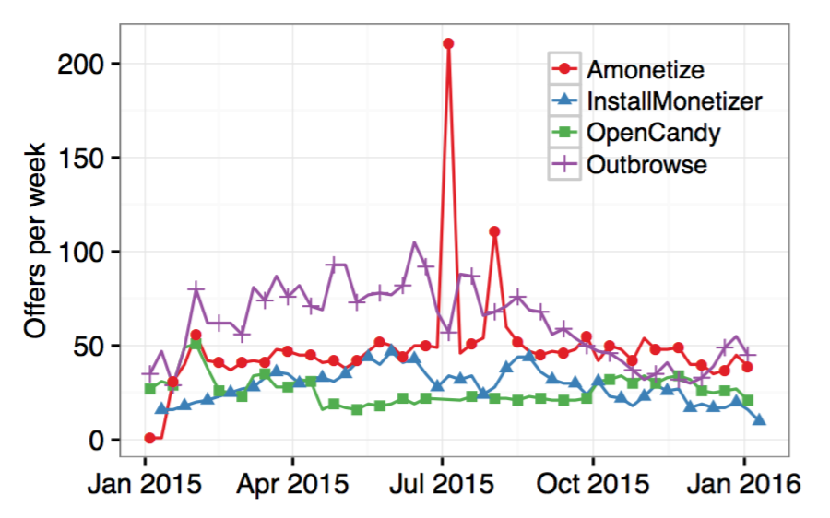
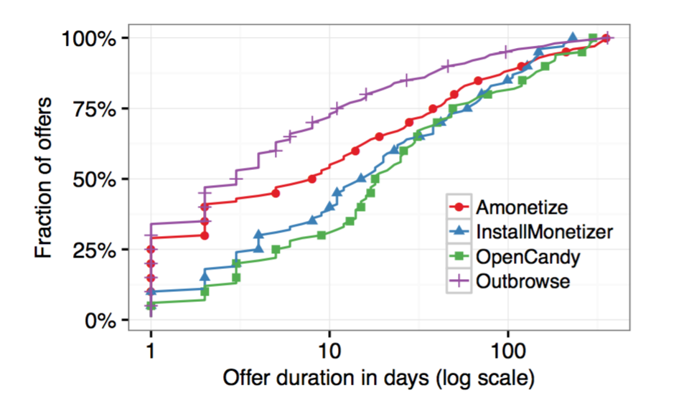
High-Level Metrics
Notes:
左邊是各個PPI網路每週散布的offers量，平均一周是25-60個（圖內每個點大約是兩週標記一次）
Amonetize高起來的原因不明白，作者說跟他們的設計無關
右邊的圖是不同PPI網路提供的offer的生命週期，
Amonetize和Outbrowse都在少於一週的時間就走到中期,
但另外兩個都要到15天左右才會到中期

Slide 39
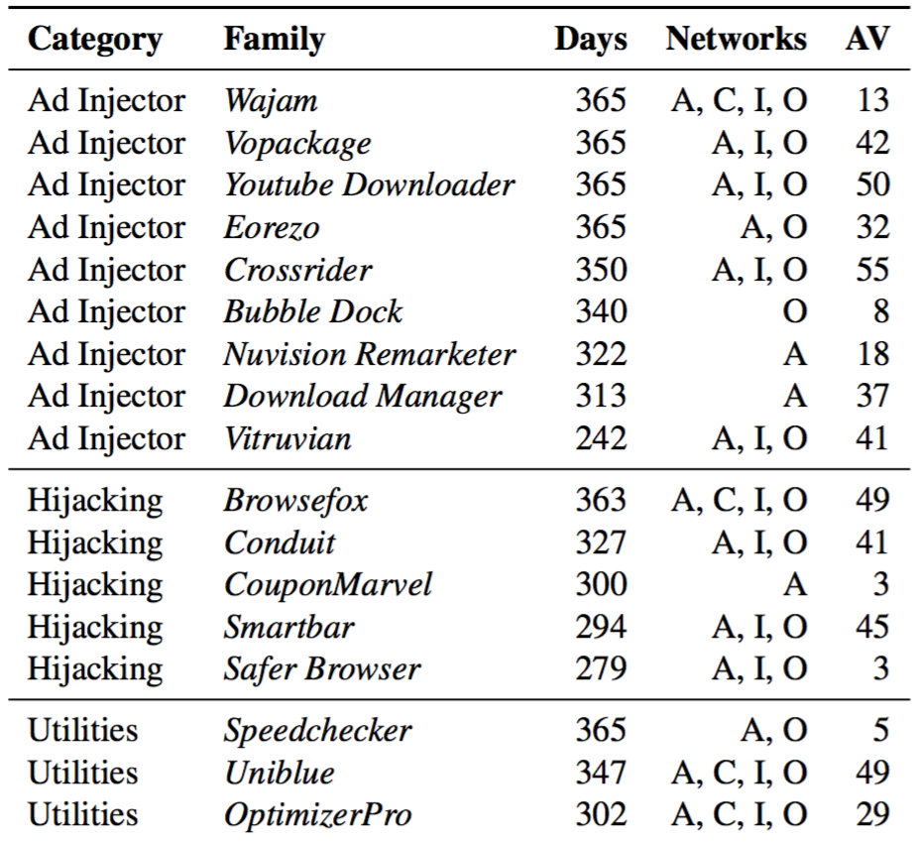
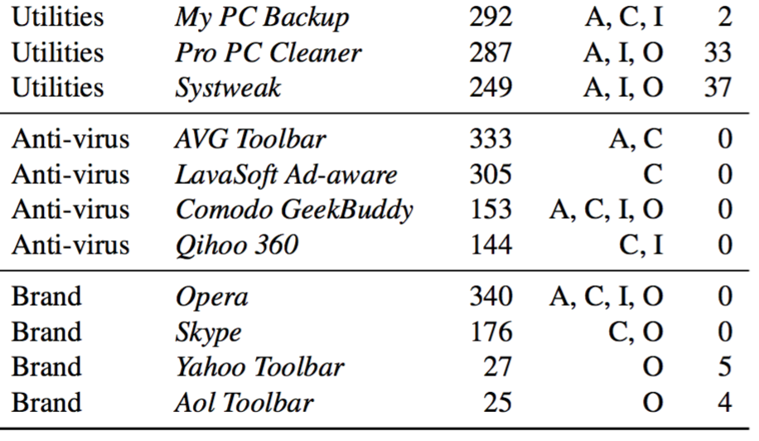
Longest Running Campaigns
Notes:
前面提到總共分群分出了873個家族，為了有效投入資金，作者他們去檢查哪些家族是長期出現在PPI network中的。
總共挑了28個家族，分成5大類：Ad Injector, Browser Settign Hijacker, System Utilities, Anti-Virus 跟一些Major Brand
旁邊的Network欄的英文字母 [A]monetize, Open[C]andy, [I]nstallMonetizer, and [O]utbrowse

Slide 40
Longest Running Campaigns – Ad Injectors
Ad Injector – Ad injectors modify a user’s browsing experience to replace or insert additional advertisements that otherwise would not appear on a website.
Of the top eight contributors to ad injection in 2014 for Chrome, Firefox, and Internet Explorer, authors observe six currently in the PPI ecosystem.
The companies behind these software products are commercial entities that span the globe. (e.g., Wajam is from Canada, Eorezo is from France)
These ad injectors recuperate the initial sunk cost of installs by monetizing users via display ads and shopping helpers until a victim finally uninstalls the injector.
Notes:
Ad Injector會去在使用者瀏覽網頁時，插入一些廣告
2014年前八大的ad injection有6個都透過PPI來散步
這些背後的公司來自世界各地
他們獲利來源是不斷地塞廣告或是有shopping helper叫user買東西

Slide 41
Longest Running Campaigns – Browser Hijackers
Browser Setting Hijackers – Settings hijackers modify a victim’s default browser behavior, typically to change the default tab or search engine to a property controlled by the hijacker.
These companies subsequently monetize victims by selling their traffic to search engines and potentially tracking user behavior.
Some hijackers also profit by doubling as ad injectors.
Notes:
B.S.H.會改瀏覽器的一些設定，例如預設的搜尋引擎或分頁內容
獲利的方法是賺一些流量，同時也可能偷偷追蹤user 行為
有的會同時具有ad injector的特色

Slide 42
Longest Running Campaigns – System Utilities
System Utilities – System utilities attempt to upsell users using potentially deceptive practices, with some meeting anti-virus definitions of scareware.
These families repeatedly generate pop-up warnings until a victim either pays a subscription fee or uninstalls the software.
This category includes “speedup” utilities and “cloud backup” utilities
Notes:
S.U.通常是會用欺騙的手法來迫使user買一些軟體或用付費功能等，有時候被防毒系統稱為恐嚇軟體
包含什麼系統加速工具、雲端備份工具等

Slide 43
Longest Running Campaigns – Others
Some Anti-Virus and Major Brands distributed via PPI
anti-virus : AVG, LavaSoft, Comodo, and Qihoo.
Major Brands : Opera, Skype, Yahoo Toolbar, Aol Toolbar.
Opera directly interacts with PPI operators to purchase installs
Other programs all operate affiliate programs to outsource installs
Notes:
有些Anti-Virus和大品牌像是Opera跟Skype也有出現在PPI network中，成為advertiser，有些同時也成為publisher

Slide 44
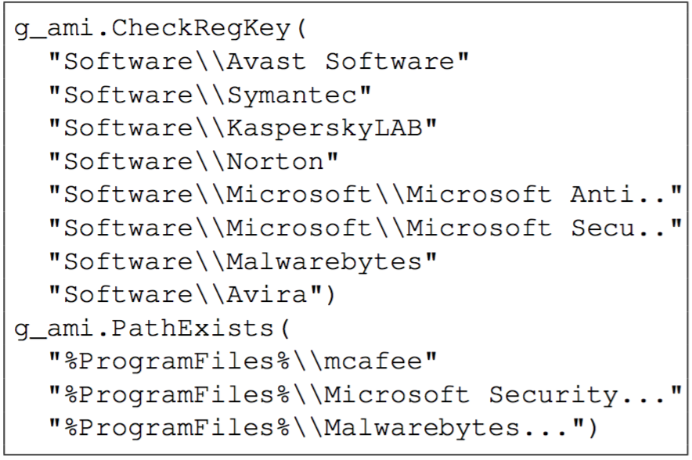
Contending with Anti-Virus
Each PPI network provides advertisers with a capability to pre-check whether an anti- virus engine is present prior to displaying the advertiser’s offer.
This pre-check consists of a blacklist of registry keys, file paths, and registry strings specified by the advertiser.
Notes:
前面有提到，PPI downloader（下載器）會在下載advertiser的binary之前先去檢查user的機器
有些是利用黑名單的方式列出一堆ATV的資料

Slide 45
Contending with Anti-Virus
Of the unique offers in our dataset, 20% take advantage of PPI downloader capabilities that prevent installs from occurring on clients running an anti-virus engine.
When anti-virus checks are present, authors find advertisers target an average of 3.6 AV families.
The most frequently targeted brands include ESET, Avast, AVG, McAfee, Avira, and Symantec.
Notes:
經過測試，作者他們發現有至少20%的downloader會檢查ATV，然後避免被安裝於有防毒的環境
作者認為上面的比例有可能會被低估，因為有可能PPI download是靠檢查有沒有Anti-Virus的副作用而不是只靠名字來檢查

Slide 46
Contending with Anti-Virus
Authors also observe offers checking for registry keys related to VirtualBox, VMWare, and OpenVPN. There are two possible interpretations of this behavior:
advertisers seek to protect themselves from fraudulent installs on virtualized systems
advertisers actively prevent installations on suspected security testing environments.
Notes:
同時也會檢查registry key 是不是有和虛擬機相關的key 或是OpenVPN
來避免被裝在虛擬測試環境

Slide 47
Outline
Introduction
Illustrate PPI Affiliate Structure
Monitoring the PPI Ecosystem
Exploring Commercial PPI Offers
Measuring User Impact
Distribution Techniques
Conclusion
Notes:
接下來講一些對使用者造成的影響

Slide 48
Requests for PPI Downloaders
Authors rely on two datasets to estimate the volume of weekly downloads to software monetizing through Amonetize, InstallMonetizer, OpenCandy, and Outbrowse:
pings reported by browsers integrated with Safe Browsing for downloaded binaries
Safe Browsing’s repository of over 75 million binaries
From this repository, authors identify 1.5 million binaries tied to one of the four PPI networks they study.
Notes:
首先，來講一下每個禮拜有多少unwanted software被使用者下載
作者是透過兩個dataset來去評估他們挑的四個PPI network每週有多少binaries被下載
一個dataset是瀏覽器如果下載了這些binary，瀏覽器整合的Safe Browsing有做回報，這些回報是一個dataset
第二個dataset是safe browsing的知識庫裡面有7500萬的binaries，這些包含benign跟unwanted
作者從這兩個dataset挑出了150萬個binaries是從那四個PPI發出的

Slide 49
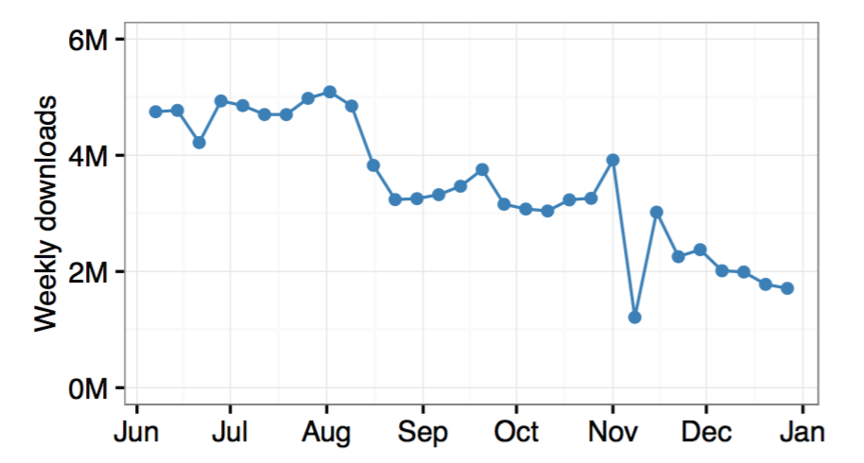
Requests for PPI Downloaders
They found that publishers for the four PPI networks drive an average of 3.5 million downloads per week, though the volume appears to be in decline.
Notes:
這四個PPI每週平均帶來350萬的下載量，是一個很可怕的量，指出了PPI對於unwanted software的散布起到的作用

Slide 50
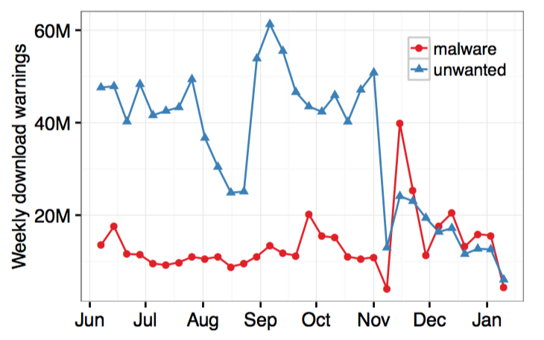
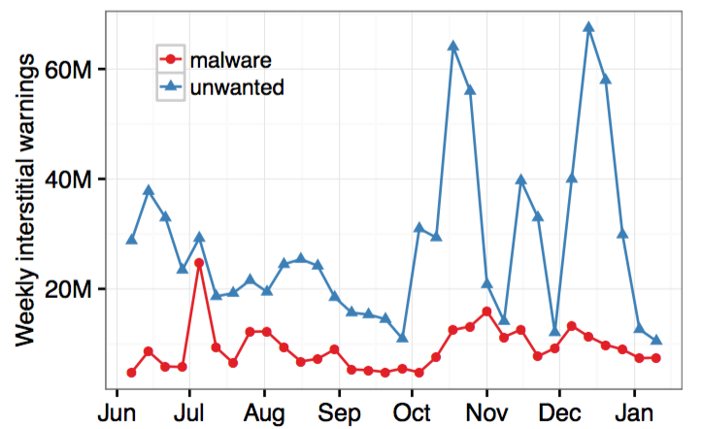
PPI Downloader Warnings
Weekly download warnings displayed by Safe Browsing
Weekly page-level interstitials displayed by Safe Browsing
Notes:
為了更完整地看出整個PPI network ecosystem對使用者的影響，作者透過Safe Browsing來統計每週有多少警告的量。
因為有些publisher會躲避偵查，所以Safe Browsing是用一個CAMP的系統來做到全面的檢查。
CAMP – Content-agnostic malware protection system
是基於3百萬個PPI downloader建起來的系統，會對網站擁有那些惡意的binaries和相關的連結做個評分等
左邊是跳出的下載警告 右邊是整頁的那種安全性警告
時間從15年6月到16年1月
每週約有3500萬個下載警告和2800萬個整頁的安全警告是unwanted software
是malware的三倍

Slide 51
Outline
Introduction
Illustrate PPI Affiliate Structure
Monitoring the PPI Ecosystem
Exploring Commercial PPI Offers
Measuring User Impact
Distribution Techniques
Conclusion
Notes:
最後是講一些PPI散佈的方法，跟前面的家族特色（Ad injector, Browser Hijacker等）不太一樣

Slide 52
Landing Pages
In order to drive installs, PPI affiliates must present content to entice a victim into downloading and executing a PPI downloader. Some samples are landing pages that direct a victim to a PPI downloader.
The sites including large companies like utorrent.com, savefrom.com; download portals like filehippo.com; and video and media torrent sites like thepiratebay.se that display deceptive ads link to PPI downloaders.
Notes:
有些PPI affiliates（在這邊可以看成是publishers）會利用landing page來把victim引到有PPI downloader的頁面
例如上面列的幾個

Slide 53
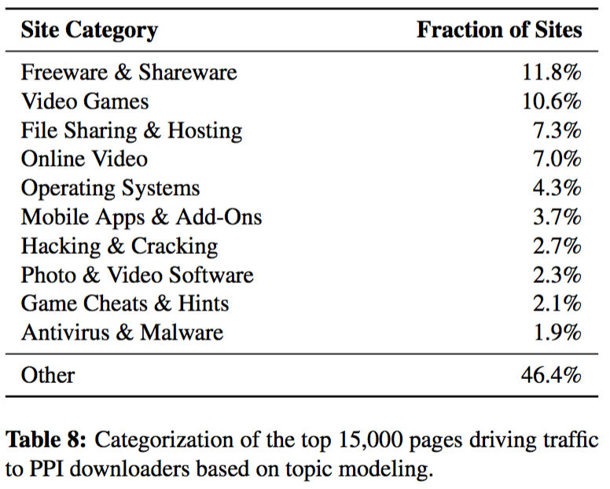
Landing Pages
Notes:
作者們去把這些landing pages的內容爬下來，分類後做了統計，如表
可以看到Freeware, Video Games, 影片種子, 破解檔等 都很容易中標

Slide 54
Distribution Pages
After a victim engages with a landing page, PPI affiliates redirect the victim to a distribution page that hosts the PPI downloader.
This site may be operated by the publisher or directly by the PPI network
Authors observed 191,372 distribution pages involved in hosting PPI downloaders through 8 months.
They find the media lifetime of each PPI network’s distribution pages.
Amonetize: 7 hours, Outbrowse: 0.75 hours, InstallMonetizer: 152 days, OpenCandy: 220 days (the entire monitoring time)
Notes:
從landing page被導頁之後，會到distribution page，就是有PPI downloader的頁面
作者也用8個月的時間去觀察這些distribution page的存活時間
OpenCandy的網頁存活時間這麼長有部分是因為Safe Browsing 並沒有跳出警告，因為他們沒有觸發Google的unwanted software policy
另一部分可能是因為前兩者在藏他們的網頁時(churning)，是很簡單的換個domain而已. （作者沒講是怎麼換的）

Slide 55
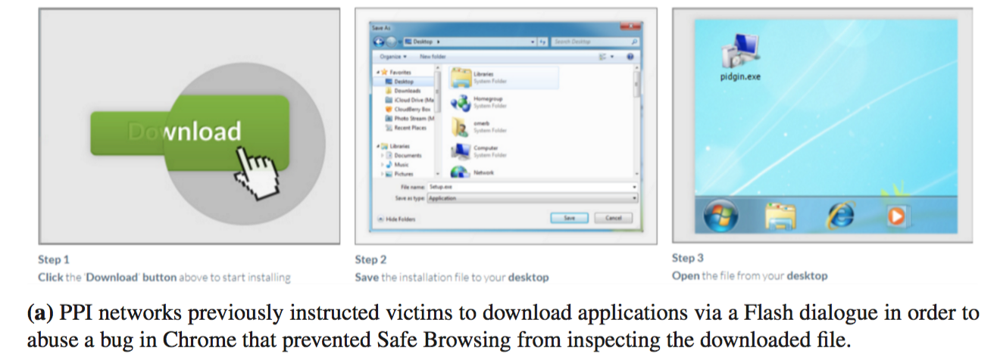
Evasion & Cloaking
Notes:
有一些PPI network downloader會躲Anti-Virus的偵查，這邊講一些方法：
在以前Chrome是有bug的，如果是flash dialogue（彈出視窗）的下載方式，Safe Browsing不會做檢查
但這個bug後來在新版被修正好了

Slide 56
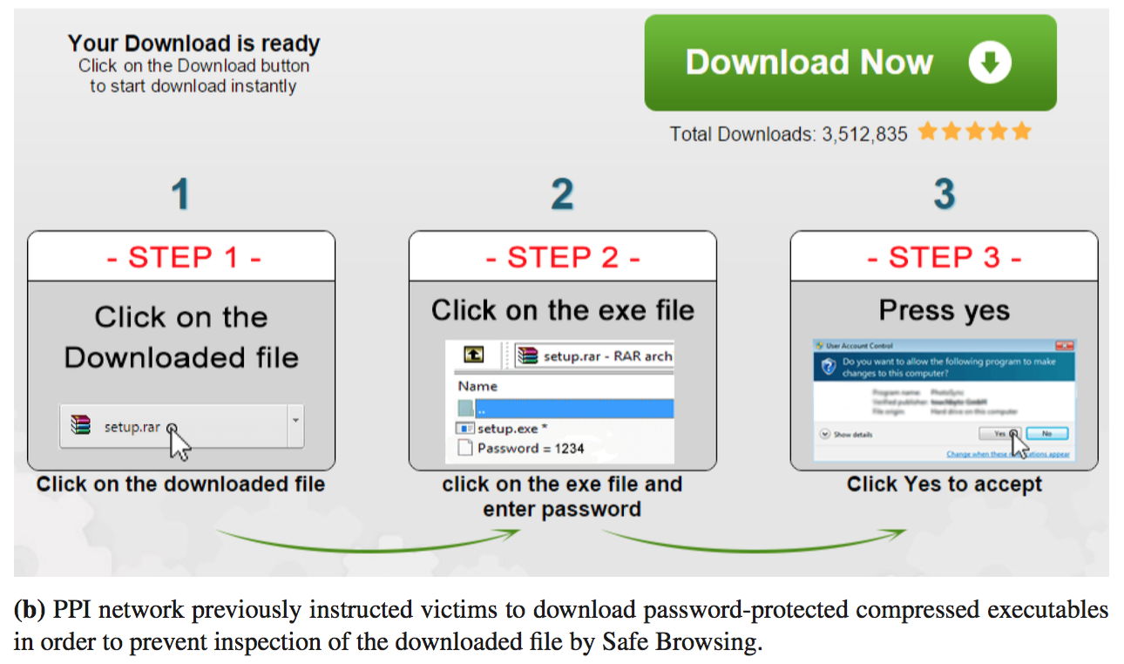
Evasion & Cloaking
Notes:
第二種方法是有些PPI downloader會改變下載器的壓縮方法，因為通常一開始防毒軟體會先掃描exe檔，此時會下載器會用zip壓縮，當後來防毒擴充掃描範圍時，就用更複雜的壓縮方法例如.rar或是.ace甚至雙重壓縮
再後來又衍伸出像圖上的這種有密碼的方式，並且會有教學怎麼解開

Slide 57
Outline
Introduction
Illustrate PPI Affiliate Structure
Monitoring the PPI Ecosystem
Exploring Commercial PPI Offers
Measuring User Impact
Distribution Techniques
Conclusion

Slide 58
Conclusion
This work presented the first deep dive into the business practices underpinning the commercial pay-per- install ecosystem that sells access to user systems for prices ranging from $0.10–$1.50 per install.
Authors showed evidence that commercial PPI networks actively attempted to evade user protections in order to sustain their business model.
Authors show the massive influence that PPI networks have on unwanted software distribution.
Notes:
這篇論文是第一個去深入研究Commercial PPI環境的文章，並找出了一個價碼的範圍
也證明PPI network為了他們的business model會努力去避免user的protection，並把advertiser當成首要服務對象
同時證明了PPI network對散佈unwanted software的重大影響

